Slide 1

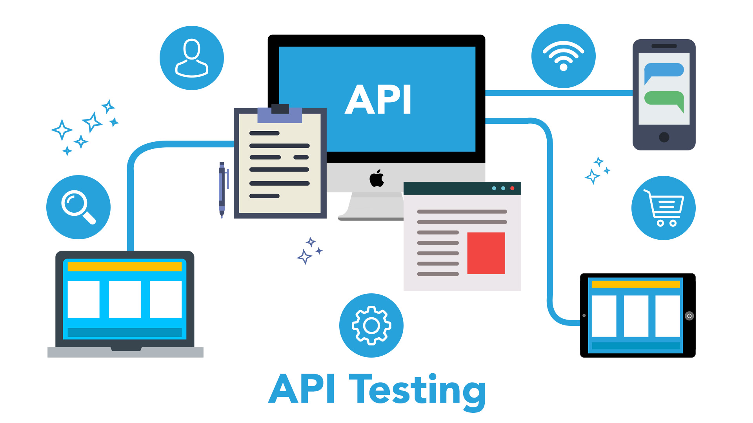
Prepared by Jeswin George ​
Internal​

Slide 2
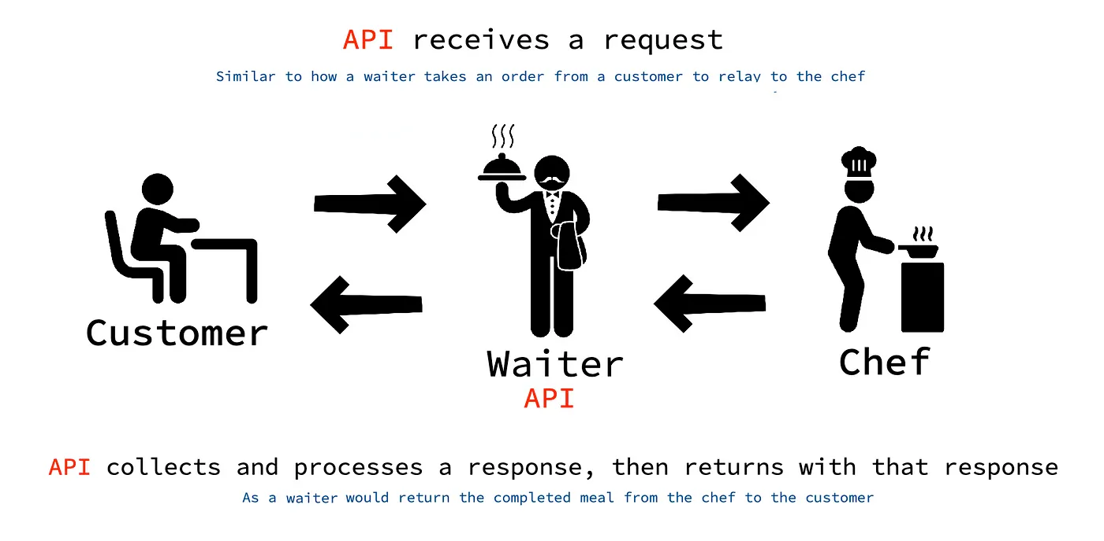
A waiter takes the order from the customer which is then relayed to the chef. Once the chef completes the meal, the waiter brings the meal to the customer. Similarly, an API receives a request from an application. It then interacts with a foreign server/data source to collect and process a response, which is then returned to the application.

Slide 3
What is an API?
An API, or application programming interface, is a set of defined rules that enable different applications to communicate with each other. It acts as an intermediary layer that processes data transfers between systems, letting companies open their application data and functionality to external third-party developers, business partners, and internal departments within their companies

Slide 4
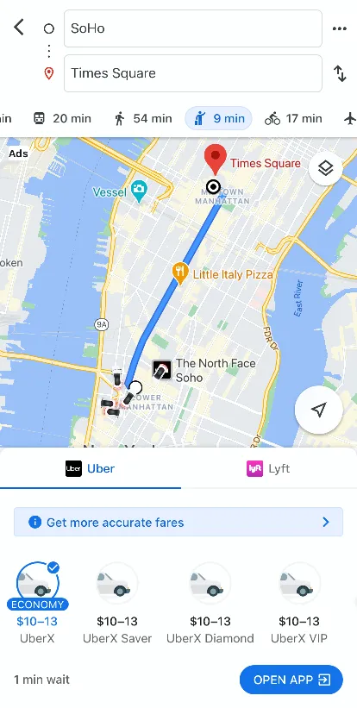

Real World Examples

Slide 5
When you search for directions on Google Maps, have you ever noticed that there is an option to book a ride from different ride services?
In this example, Google Maps is using Uber’s API to request information by sending a HTTP request function with the start and end points of the ride.
Uber’s API then sends information back such as how many cars are available, where are they currently located, and the costs for the various ride options.
This information is then processed by Google Maps and is available to the user directly linking them the the Uber app if it is previously downloaded.

Slide 6
Different API Methods
Post
Get
Delete
Patch
Put

Slide 7
Method | Description
GET | Retrieve information about the API resource
POST | Create API resource
PUT | Update API resource
DELETE | Delete API resource or related component
PATCH | update only the fields of the resource if it exists

Slide 8
Why use an API?
APIs serve numerous purposes. REST APIs offer four main benefits:
1. Integration
APIs are used to integrate new applications with existing software systems. This increases development speed because each functionality doesn’t have to be written from scratch. You can use APIs to leverage existing code.
2. Innovation
Entire industries can change with the arrival of a new app. Businesses need to respond quickly and support the rapid deployment of innovative services. They can do this by making changes at the API level without having to re-write the whole code.

Slide 9
3. Expansion
APIs present a unique opportunity for businesses to meet their clients’ needs across different platforms. For example, maps API allows map information integration via websites, Android,iOS, etc. Any business can give similar access to their internal databases by using free or paid APIs.
4. Ease of maintenance
The API acts as a gateway between two systems. Each system is obliged to make internal changes so that the API is not impacted. This way, any future code changes by one party do not impact the other party.

Slide 10
How is an API URL structured?
An API URL is structured exactly like a "regular" website URL, but the naming conventions are a bit different, and they typically adhere to a stricter organizational logic. There are 3 parts to an API URL:
https://api.stripe.com/v1/charges?limit=100
Base url Endpoint Query parameters

Slide 11
The base URL. The base URL is the initial part of the API URL. Typically all API requests to that API will use the same base URL. For example, Stripe's base URL is https://api.stripe.com/v1/
The endpoint. The endpoint identifies which data table you want to access. For example, Stripe has endpoints for /balance, /charges, /customers, and so on.
Query parameters. Query parameters come after an initial question mark, and are generally used to filter or customize the API request. For example, adding ?limit=100 to the request would pull in 100 records.

Slide 12
Rest API Response Codes
Table 1. REST response codes
Response code | Description
200 OK | Request accepted, response contains result. This is a general purpose response code that can be returned from any request. For GET requests, the requested resource or data is in the response body. For PUT or DELETE requests, the request was successful and information about the result (such as new resource identifiers, or changes in resource status) can be found in the response body.
201 CREATED | This response code is returned from PUT or POST, and indicates that a new resource was created successfully. The response body might for example contain information about a new resource, or validation information (for example, when an asset is updated).
204 NO CONTENT | Indicates that the request was accepted but that there was nothing to return. This is returned when the request was processed, but no additional information about the result has been returned.
400 BAD REQUEST | The request was not valid. This code is returned when the server has attempted to process the request, but some aspect of the request is not valid, for example an incorrectly formatted resource or an attempt to deploy an invalid event project to the event runtime. Information about the request is provided in the response body, and includes an error code and error
Here are some sample Response Codes which we will normally see while performing REST API testing over POSTMAN or over any REST API client.
2xx: Success – Indicates that the client’s request was accepted successfully.
4xx: Client Error – This category of error status codes points the finger at clients
5xx: Server Error – The server takes responsibility for these error status codes.

Slide 13
401 UNAUTHORIZED | Is returned from the application server when application security is enabled, and authorization information was missing from the request.
403 FORBIDDEN | Indicates that the client attempted to access a resource which they do not have access to. This might be encountered if the user accessing the remote resource does not have sufficient privileges; for example, by having the WBERestApiUsers or WBERestApiPrivilegedUsers role. Users who attempt to access private event projects owned by other users might also see this error, but only if they have the WBERestApiUsers role rather than the WBERestApiPrivilegedUsers role.
404 NOT FOUND | Indicates that the targeted resource does not exist. This might be because the URI is malformed, or the resource has been deleted.
405 METHOD NOT ALLOWED | Returned when the targeted resource does not support the requested HTTP method; for example, the functions resource only allows GET operations.
406 NOT ACCEPTABLE | The data format requested in the Accept header or accept parameter is not supported by the targeted resource. That is, the client has requested that data is returned in a particular format, but the server is unable to return data in that format.
409 CONFLICT | Indicates that a conflicting change has been detected during an attempt to modify a resource. The response body provides further information.
415 UNSUPPORTED MEDIA TYPE | The data format of the request body, specified in the Content-Type header, is unsupported by the targeted resource.
500 INTERNAL SERVER ERROR | An internal error occurred in the server. This might indicate a problem with the request, or might indicate a problem in the server side code. Error information can be found in the response body.

Slide 14
Difference between REST API and SOAP API
Sr. No. | Key | REST API | SOAP API
1 | Implementation | Rest API is implemented as it has no official standard at all because it is an architectural style. | On other hand SOAP API has an official standard because it is a protocol.
2 | Internal communication | REST APIs uses multiple standards like HTTP, JSON, URL, and XML for data communication and transfer. | SOAP APIs is largely based and uses only HTTP and XML.
3 | Resource requirement | As REST API deploys and uses multiple standards as stated above, so it takes fewer resources and bandwidth as compared to SOAP API. | On other hand Soap API requires more resource and bandwidth as it needs to convert the data in XML which increases its payload and results in the large sized file.
4 | Description | REST API uses Web Application Description Language for describing the functionalities being offered by web services. | On other hand SOAP API used Web Services Description language for the same.
5 | Security | REST has SSL and HTTPS for security. | On other hand SOAP has SSL( Secure Socket Layer) and WS-security due to which in the cases like Bank Account Password, Card Number, etc. SOAP is preferred over REST.
6 | Abbreviation | REST stands for Representational State Transfer. | On other hand SOAP stands for Simple Object Access Protocol
7 | Interchange | REST can make use of SOAP as the underlying protocol for web services, because in the end it is just an architectural pattern. | On other hand SOAP cannot make use of REST since SOAP is a protocol and REST is an architectural pattern.

Slide 15
Stands for | SOAP Simple Object Access Protocol | REST Representational State Transfer
What is it? | SOAP is a protocol for communication between applications | REST is an architecture style for designing communication interfaces.
Design | SOAP API exposes the operation. | REST API exposes the data.
Transport Protocol | SOAP is independent and can work with any transport protocol. | REST works only with HTTPS.
Data format | SOAP supports only XML data exchange. | REST supports XML, JSON, plain text, HTML.
Performance | SOAP messages are larger, which makes communication slower. | REST has faster performance due to smaller messages and caching support.
Scalability | SOAP is difficult to scale. The server maintains state by storing all previous messages exchanged with a client. | REST is easy to scale. It’s stateless, so every message is processed independently of previous messages.
Security | SOAP supports encryption with additional overheads. | REST supports encryption without affecting performance.
Use case | SOAP is useful in legacy applications and private APIs. | REST is useful in modern applications and public APIs

Slide 16

Testing

Slide 17
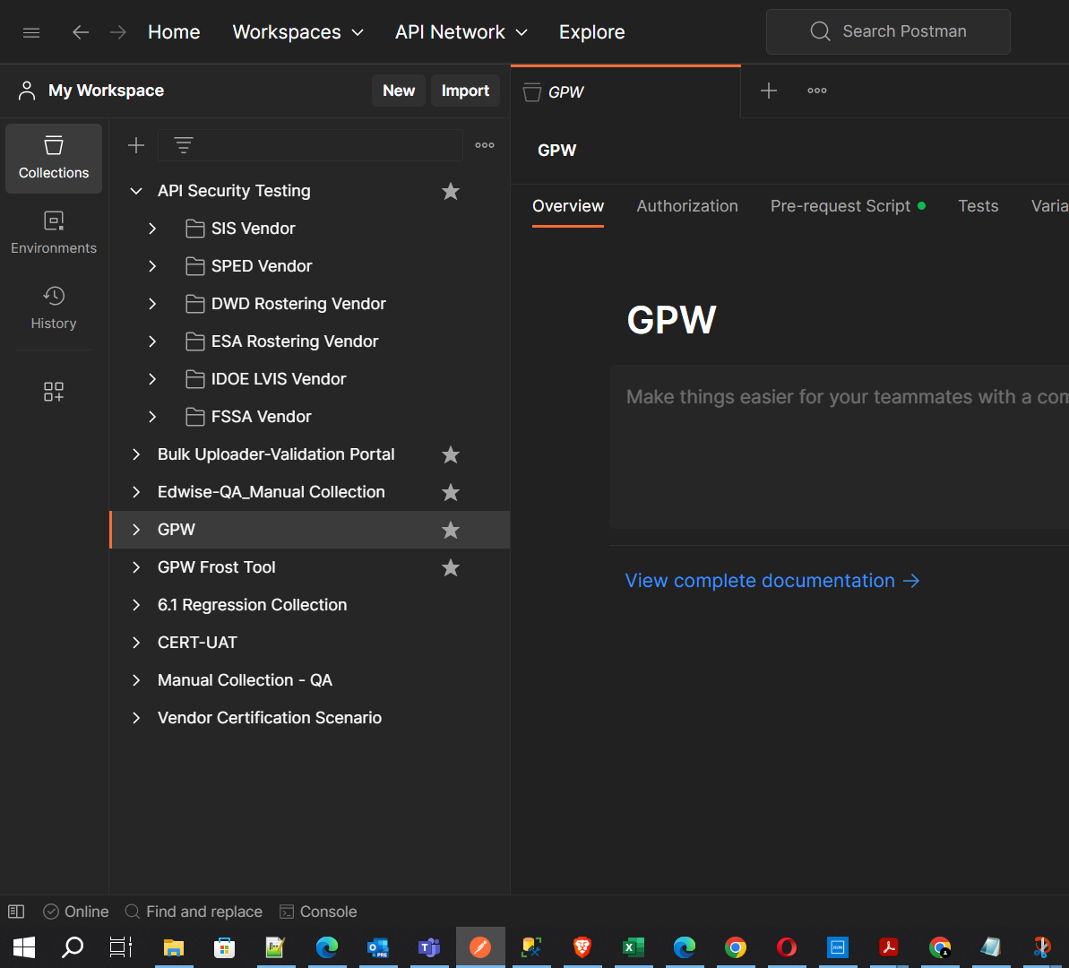
Collections
Postman Collections are a group of saved requests.
Multiple requests can be grouped together into multiple folders inside one collection based on business needs.
The folder hierarchy can go multiple level deep.

Slide 18
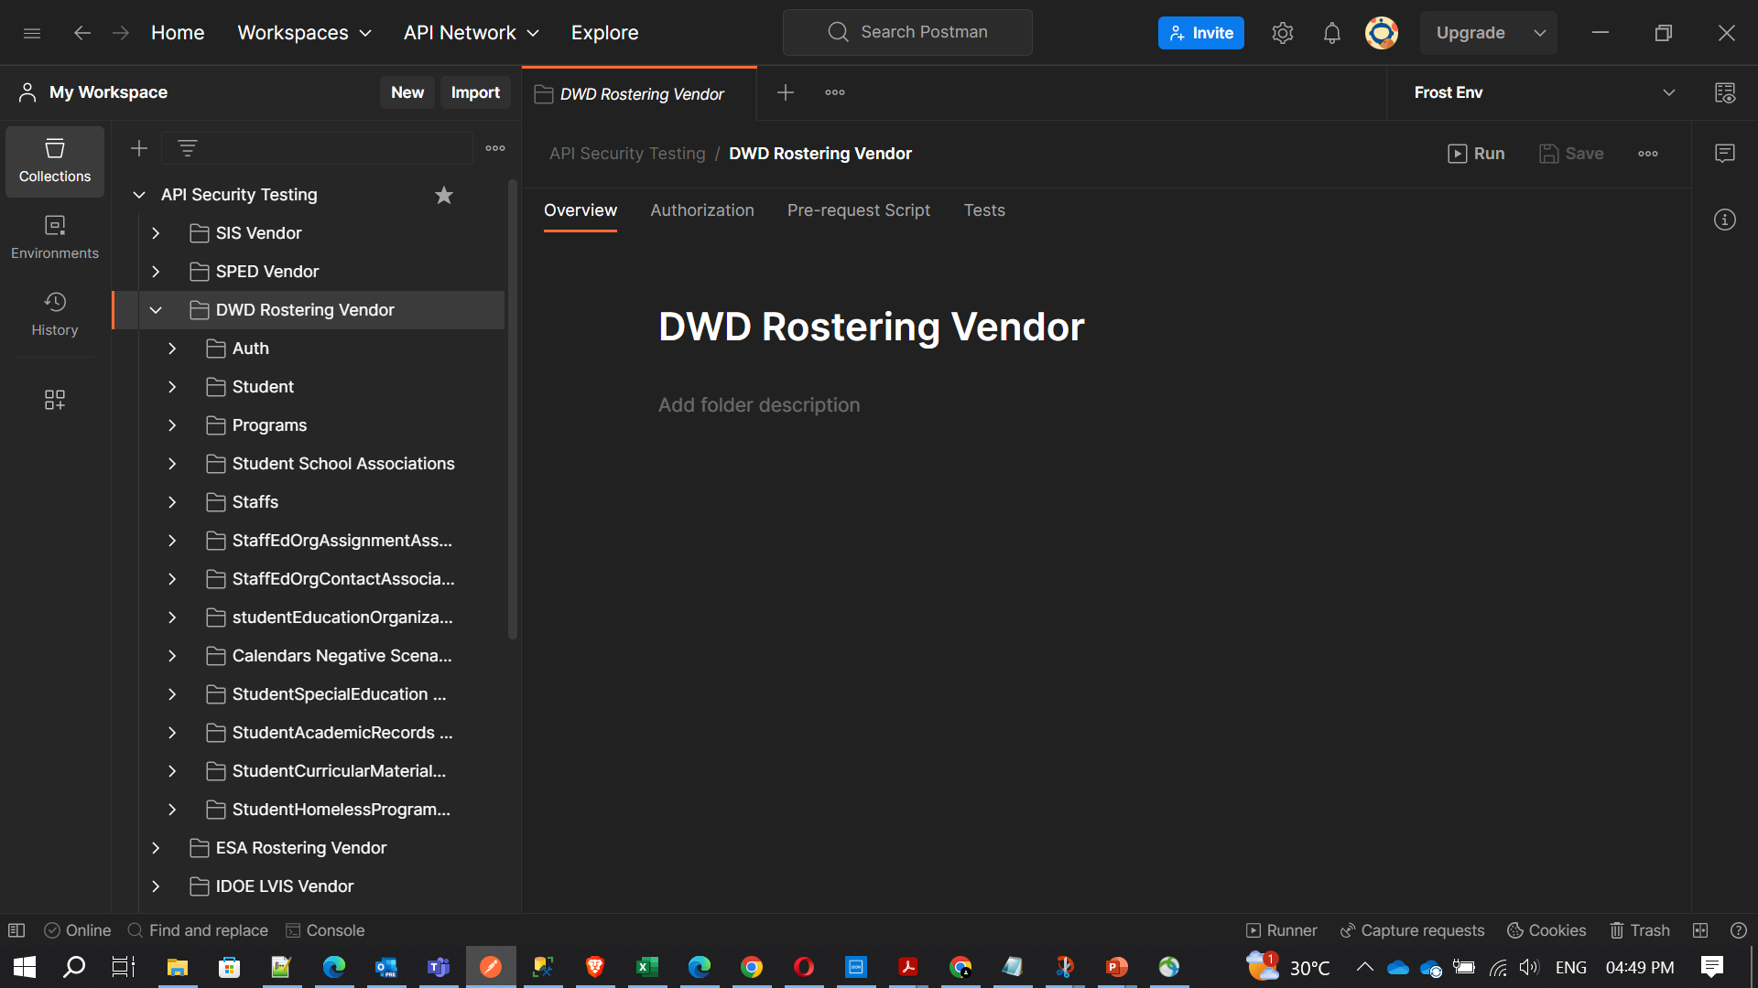

Slide 19
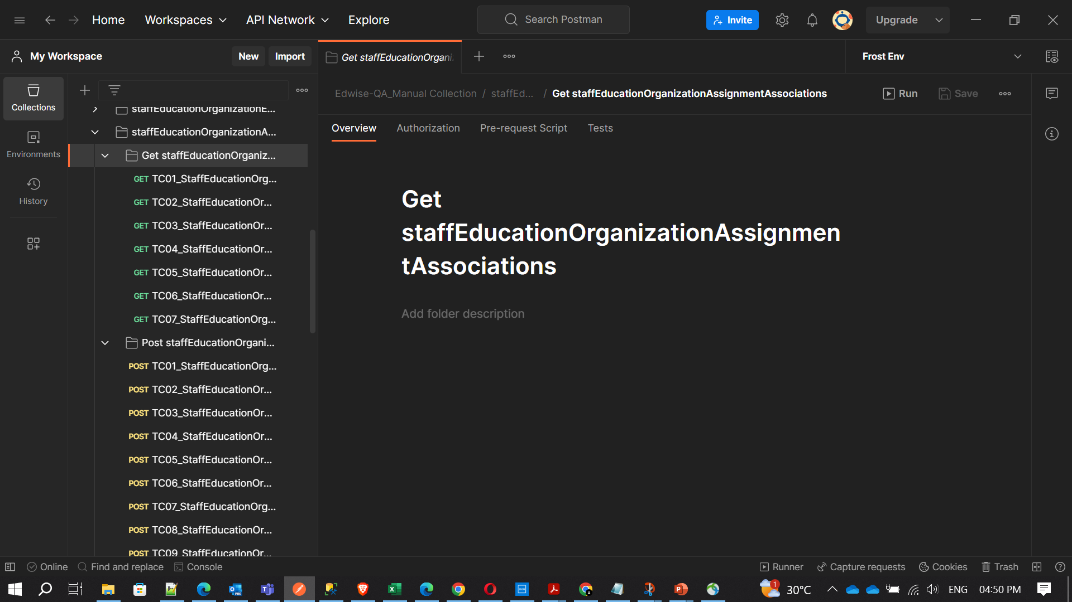

Slide 20
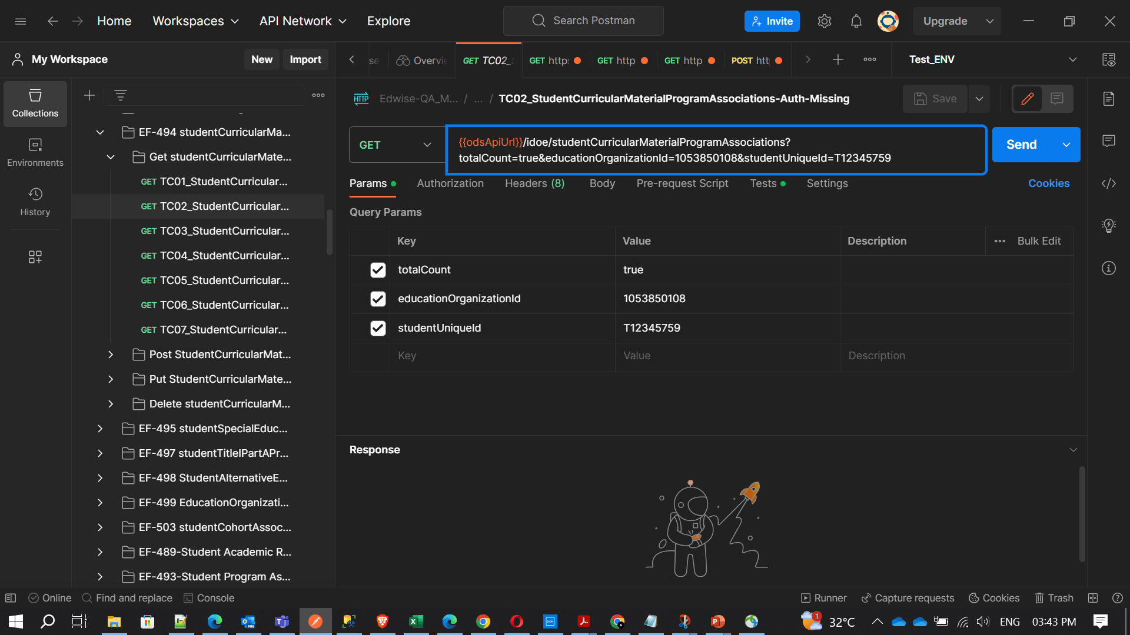
Request parameters are used to send additional information to the server. A URL contains these parameters

Slide 21

Parameters
Request parameters are used to send additional information to the server.
Params option is available on the left side of the URL text field. This option will offer you additional text fields under the URL field to enter the query parameters in the form of key-value pairs.
Once you enter parameters in the Params text field, then these parameters will automatically be added to the URL.

Slide 22
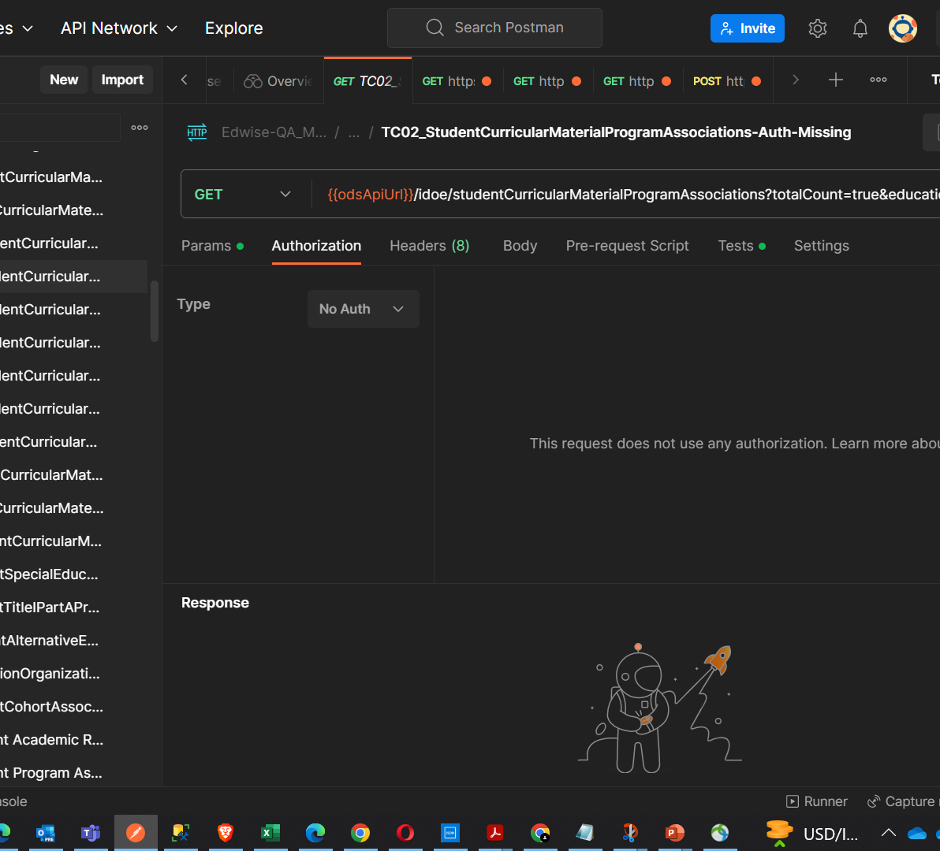
Authorization
In Postman, authorization is done to verify the eligibility of a user to access a resource in the server.
This is done within the Authorization tab in Postman.

Slide 23
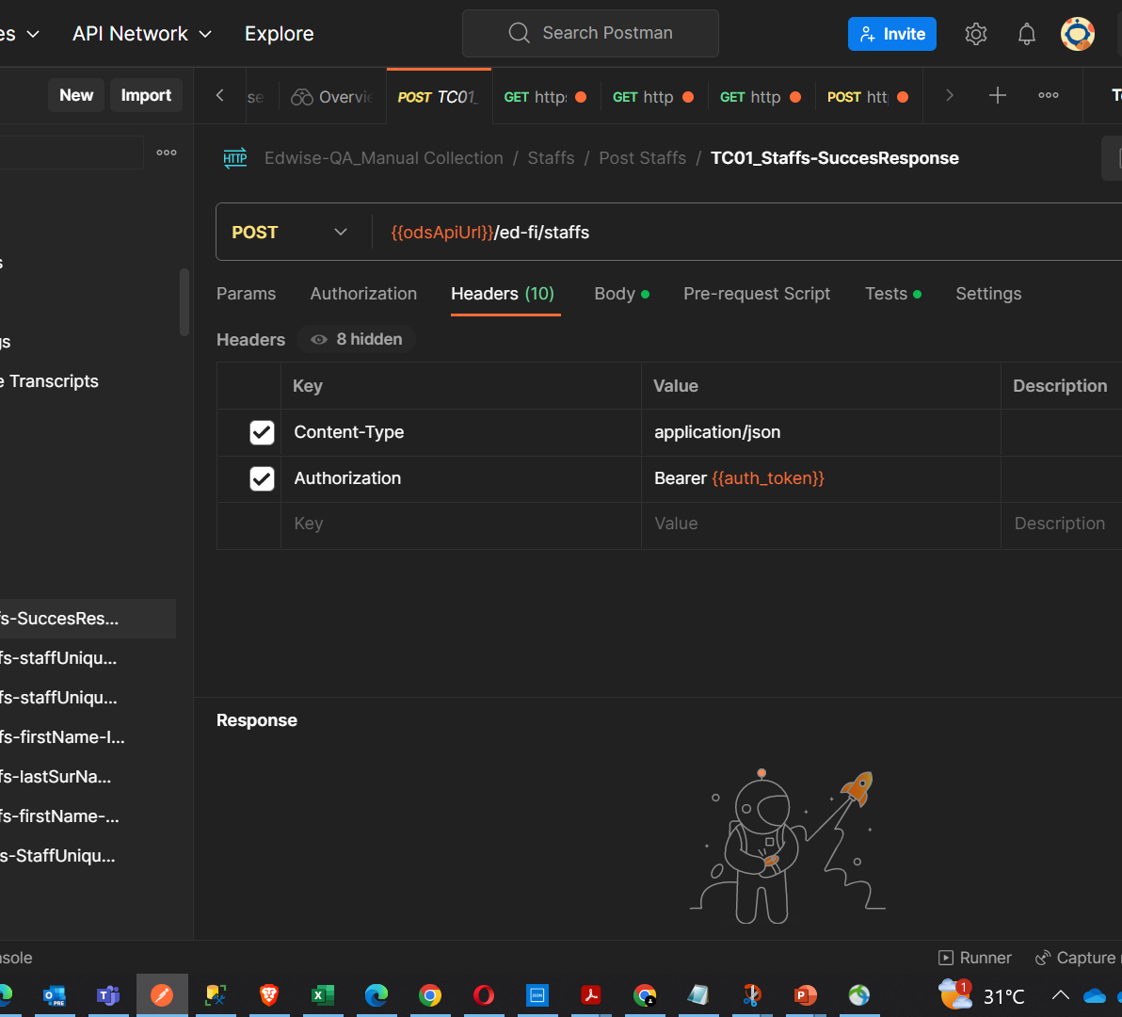
Headers
Some APIs require you to send particular headers along with requests, typically to provide more metadata about the operation you are performing. You can set these up in the Headers tab. Enter any key-value pairs you need and Postman will send them along with your request.

Slide 24
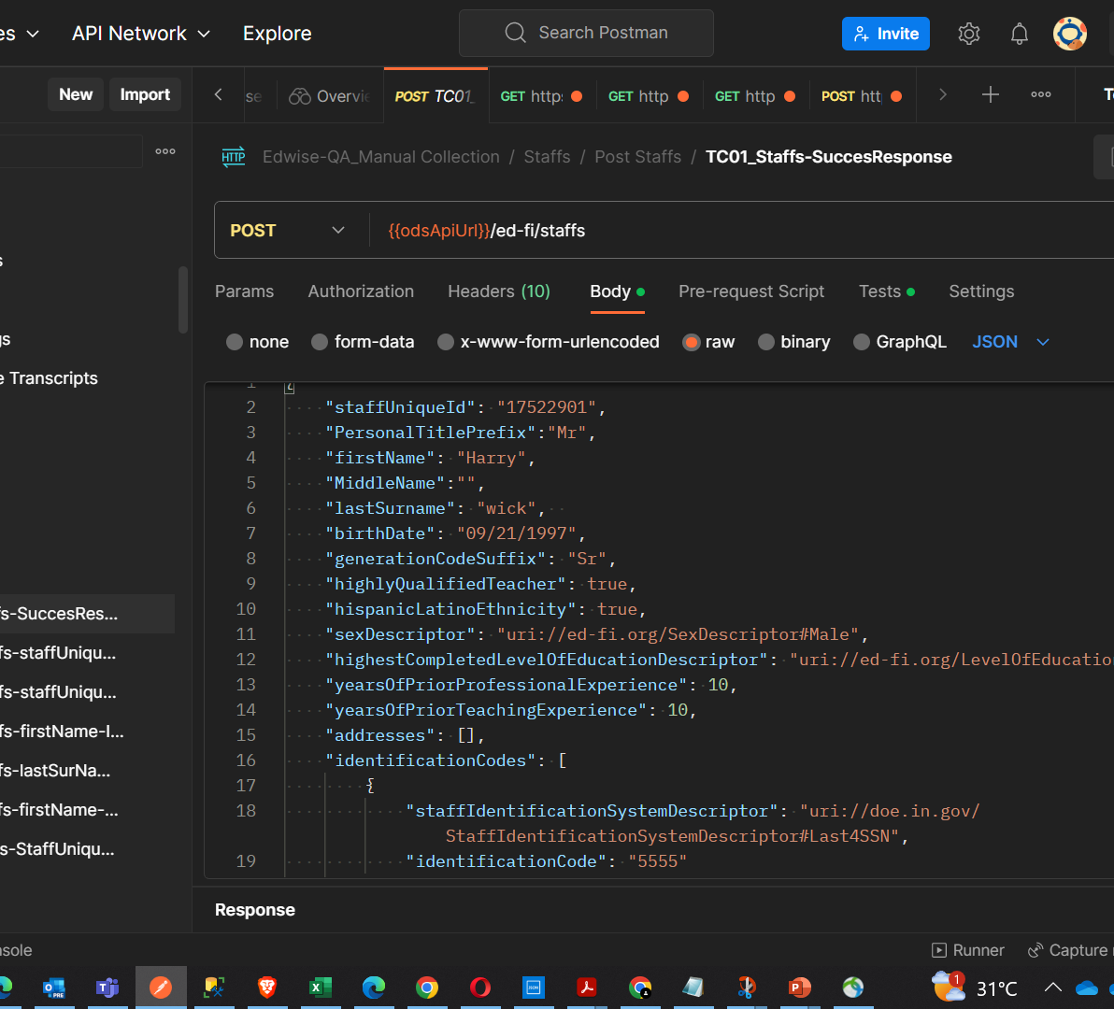
Body
You will need to send body data with requests whenever you need to add or update structured data. For example, if you're sending a request to add a new customer to a database, you might include the customer details in JSON. Typically you will use body data with PUT, POST, and PATCH requests.
The Body tab in Postman enables you to specify the data you need to send with a request.

Slide 25
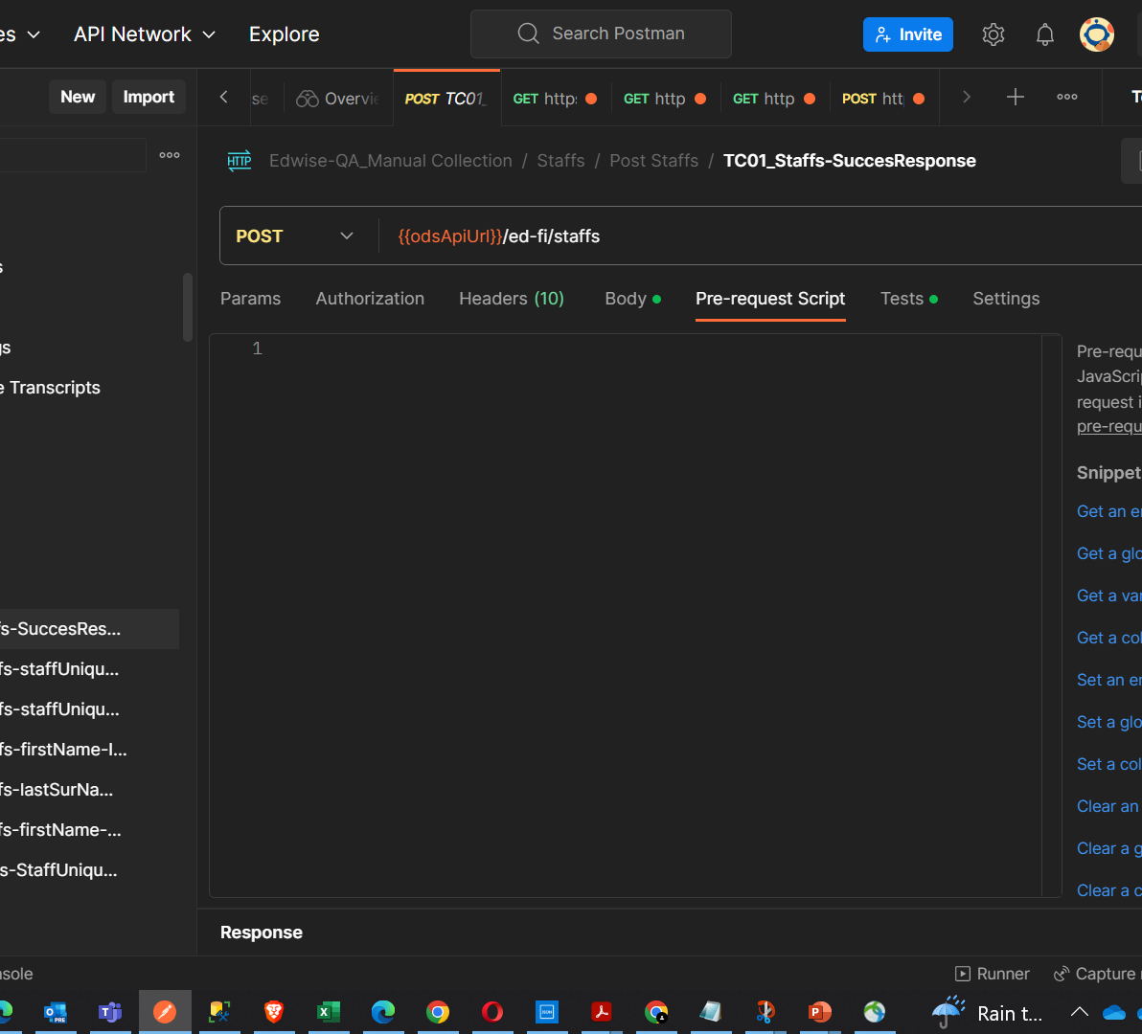
Pre-request Script
You can use pre-request scripts in Postman to execute JavaScript before a request runs. By including code in the Pre-request Script tab for a request, collection, or folder, you can carry out pre-processing such as setting variable values, parameters, headers, and body data..

Slide 26
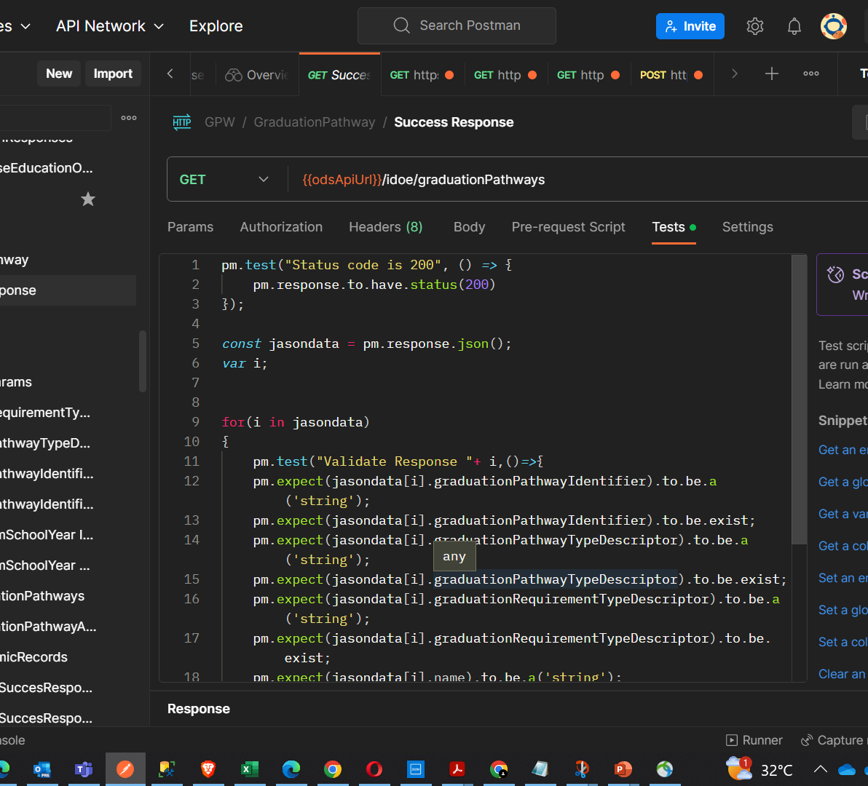
Post-Response Script
Post-response scripts confirm that your API is working as expected, that integrations between services are functioning reliably, and that any changes haven't broken existing functionality. You can write scripts for your Postman API requests in JavaScript.
You can add scripts to individual requests, collections, and folders in a collection.

Slide 27
Response and Scripts

Slide 28
Response
The contents of a Postman response are considered an object because they are often returned in the JSON (JavaScript Object Notation) format,
which is a standard data interchange format. JSON data is represented as key-value pairs, similar to JavaScript objects.
However, if the response is not in JSON format, it could be referred to based on its format. Here are some examples:
If the response is in XML format, it might be referred to as an XML document.
If the response is in HTML format, it might be referred to as an HTML document or web page.
If the response is plain text, it might simply be referred to as text.

Slide 29
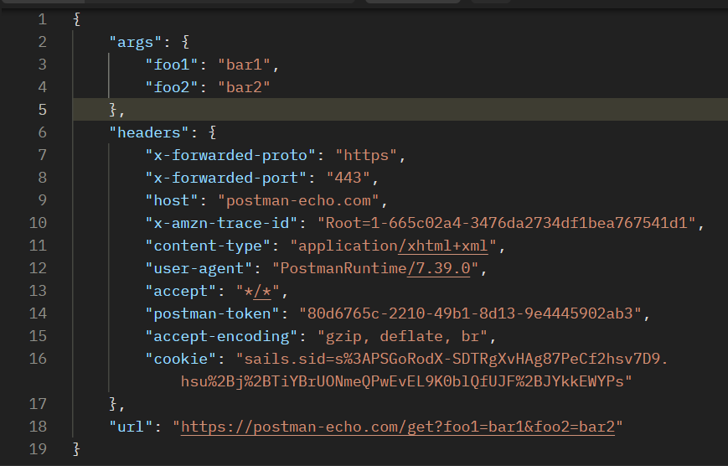
In JSON (JavaScript Object Notation), data is represented as a collection of key-value pairs. Each key-value pair is known as a property. The key is a string that represents the name of the property, and the value is the data that is associated with that key.

Slide 30
In the example given:
args, headers, and url are the keys, and their associated values are the objects or strings that follow them.
For instance, the args property has a value that is another object: { "foo1": "bar1", "foo2": "bar2" }.
The headers property has a value that is also an object, containing its own set of properties such as x-forwarded-proto, x-forwarded-port, host, etc.
The url property has a string value: "https://postman-echo.com/get?foo1=bar1&foo2=bar2".

Slide 31
Scripts in Postman

Slide 32
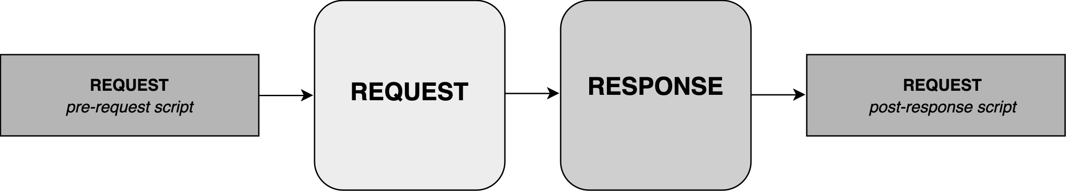
Execution order of scripts
In Postman, the script execution order for a single request looks like this:
A pre-request script associated with a request will execute before the request is sent
A post-response script associated with a request will execute after the request is sent

Slide 33
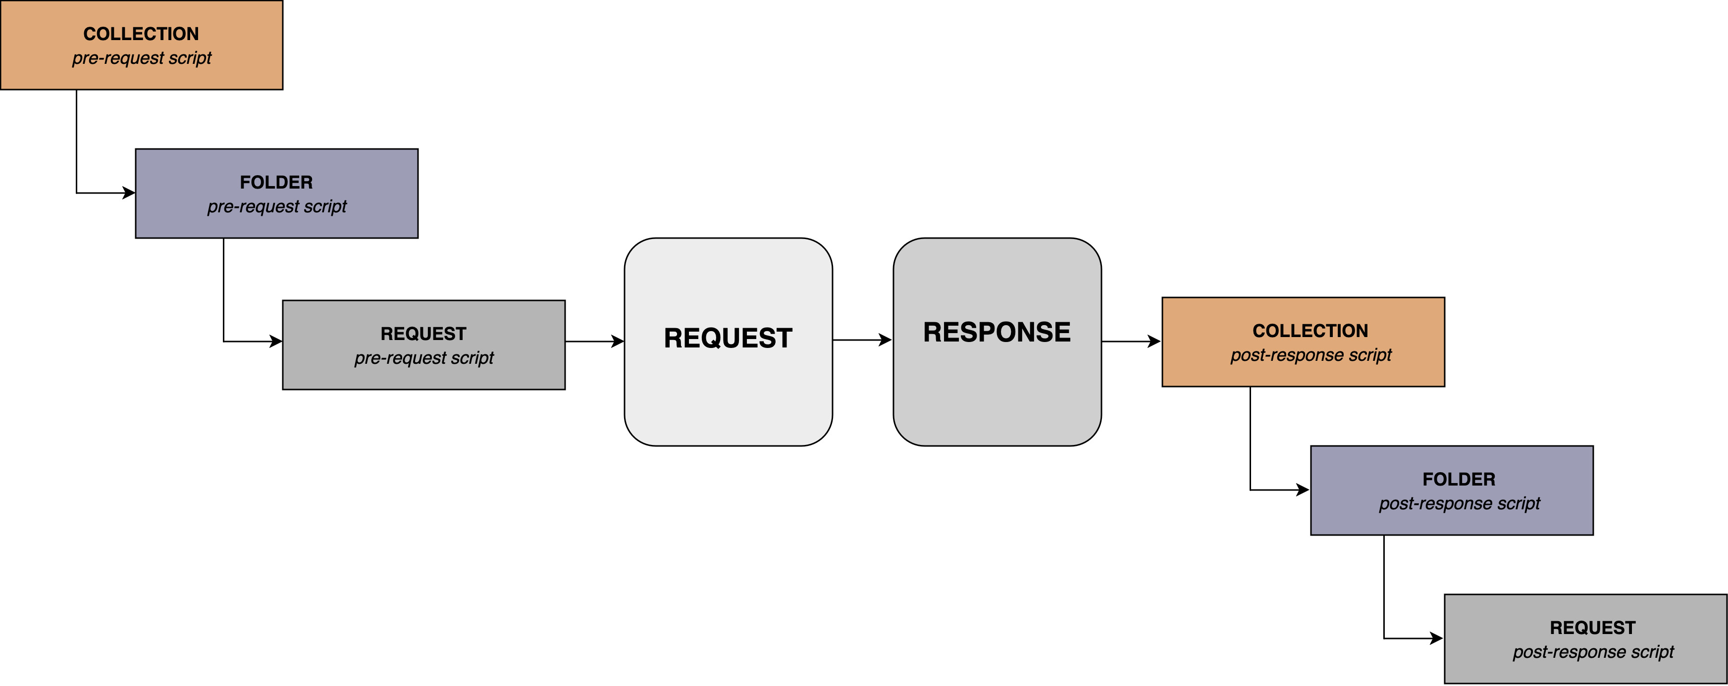
Execution order of scripts
For every request in a collection, scripts will execute in the following order:
A pre-request script associated with a collection will run prior to every request in the collection.
A pre-request script associated with a folder will run prior to every direct child request in the folder.
A post-response script associated with a collection will run after every request in the collection.
A post-response script associated with a folder will run after every direct child request in the folder.

Slide 34
Validate responses
To validate the data returned by a request, you can use the pm.response object in a test. Define tests using the pm.test function, providing a name and function that returns a boolean (true or false) value indicating if the test passed or failed. Use Chai.js BDD syntax and pm.expect in your assertions to test the response detail.
The first parameter for the .test function is a text string that will appear in the test result output. Use this to identify your tests, and communicate the purpose of a test to anyone viewing the results.

Slide 35
Pm, pm.request and pm.respone
pm is a global object in Postman that contains information about the current script execution environment.
response is an object that contains details about the HTTP response that was received. The json() method is used to parse the body of the HTTP response from a JSON string into a JavaScript object.
The first parameter for the .test function is a text string that will appear in the test result output. Use this to identify your tests, and communicate the purpose of a test to anyone viewing the results.
request is an object that contains details about the HTTP request that will be sent.

Slide 36
Difference between var, let, and const
The difference between var, let, and const is in their scoping rules:
var is function-scoped, meaning a variable declared with var is available within the function it’s declared in.
let and const are block-scoped, meaning they are only available within the block they’re declared in.

Slide 37
Example of var (function-scoped):
function testVar() {
var x = 1;
if (true) {
var x = 2; // same variable!
console.log(x); // 2
}
console.log(x); // 2
}
testVar();
In this example, var x = 2 inside the if block is not creating a new local variable, but rather reassigning the x variable in the function scope. Therefore, both console.log(x) statements are logging 2

Slide 38
Example of let and const (block-scoped):
function testLet() {
let y = 1;
if (true) {
let y = 2; // different variable
console.log(y); // 2
}
console.log(y); // 1
}
testLet();
In this example, let y = 2 inside the if block is creating a new variable that only exists within the if block. Therefore, the first console.log(y) logs 2, and the second console.log(y) logs 1

